Slide 1
Strategies for Integrating Oral and Mental Health
Mental Health/Substance Use Disorder Integration Technical Assistance
January 21, 2026
Candace Owen, Rebecca Cornille, Selynn Edwards, Marielys Santiago Matos, Migdala Perez Rivera, and Laury Rios
Health Resources and Services Administration (HRSA), Bureau of Primary Health Care (BPHC)

Slide 2
Disclosure
This webinar was produced for the Health Resources and Services Administration (HRSA), Bureau of Primary Health Care under contract number 47QRAA18D00FZ/75R60224F80097.

Slide 3
Submitting Questions and Comments
Submit questions by using the Q&A feature.
If you experience any technical issues during the webinar, please message us through the Q&A feature.

Slide 4

Objectives
Describe key strategies to implement mental health screenings in the dental clinic.
Identify several best practices of oral and mental health integration, such as universal screening, electronic health record integration, and staff training to effectively implement and sustain integration.
Learn key strategies and integration approaches used by health centers to effectively implement and sustain oral and mental health integration.
Notes:
Amber

Slide 5

Polling Question #1
How would you rate your organization’s current level of integration between dental, primary care, and mental health services?
Not integrated at all
Minimally integrated
Moderately integrated
Fully integrated
Not sure
Notes:
Amber

Slide 6
Polling Question #2
Which of the following is the biggest challenge your organization faces in integrating oral and mental health services?
Lack of funding
Workforce or training limitations
Operational or workflow barriers
Limited leadership or organizational support
Uncertainty about effective models or strategies
Other (please specify in the Q&A)
Notes:
Amber

Slide 7

Presenter/Panelist
Candace Owen, RHD, MS, MPH
Notes:
Amber I am pleased to introduce you to today’s presenter. Candace Owen is a registered dental hygienist and the Senior Director of Education & Strategic Partnerships for National Network for Oral Health Access (NNOHA). Her areas of expertise include workforce optimization, care access, and oral health integration. Before joining NNOHA, Candace served as a faculty member for the University of New Mexico Department of Dental Medicine.
It is now my pleasure to turn the webinar over to Candace. Candace, please go ahead.

Slide 8
Overview of Integrated Oral and Mental Health
8
Notes:
Candace

Slide 9
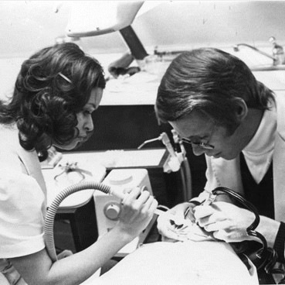

About National Network for Oral Health Access (NNOHA)
NNOHA was founded in 1991 with 9 members, to support health centers during a decline in health centers with oral health programs
Today, membership includes 5,400+ dentists, dental hygienists, dental assistants, supporters, and partners
Notes:
Founded in 1991 by FQHC Dental Directors who identified a need for peer-to-peer networking, collaboration, research, and support.
Mission: To improve the oral health of underserved populations and contribute to overall health through leadership, advocacy, and support to oral health providers in safety-net systems.

Slide 10
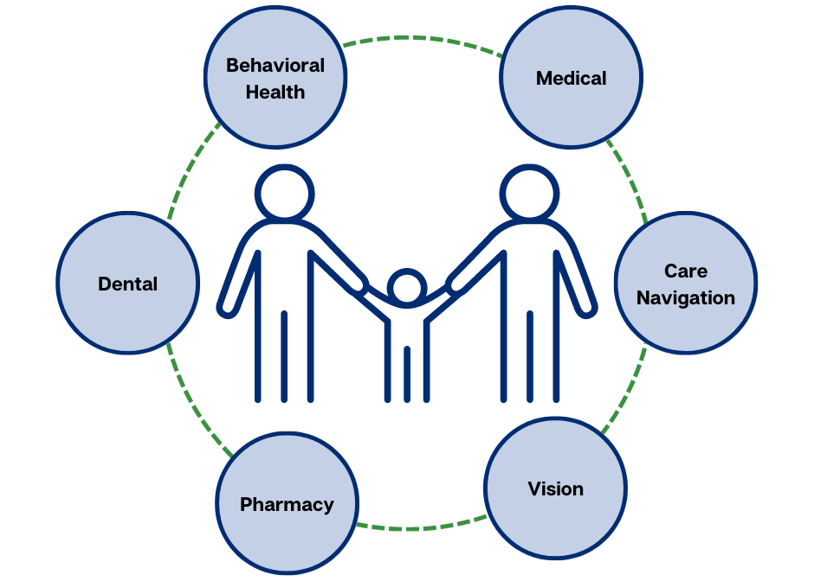
Integrated Care Framework
Mental Health
Mental Health
Medical
Care Navigation
Vision
Pharmacy
Dental

Slide 11

National Health Center Program Uniform Data System (UDS) Measure
Percentage of patients 12 years of age and older who were (1) screened for depression with a standardized tool and, if screening was positive, (2) had a follow-up plan documented.
Notes:
The depression UDS measure was released in 2003.

Slide 12
UDS Depression Screening Measure: 2019 – 2024
*Data Source: HRSA Uniform Data System

Slide 13

Dental Support for UDS Depression Screening
Helps with UDS measure
Patient-directed care
Bilateral oral health and mental health impact
What if dental screens, too?

Slide 14





Systems-level Steps to Success
Planning
Training System
Health Information Technology (IT)
Clinical Care System
Evaluation System

Slide 15
1: Planning Readiness for Integration
Leadership Buy-in
C-suite leadership/Board of Directors buy into and support integration. It is embedded in organizational environment.
Executive Team
Dental Director/Chief Dental Officer is part of the health center management team and reports directly to CEO.
Staff Buy-In
All participating department staff understand and are willing to learn about the value of integration.
Clinical Champions
There are clinical champions from all participating disciplines in the organization (e.g., dental, primary care, mental health, etc.).
Co-location
Primary care, mental health, and dental are co-located at the same community health center site.
Quality Improvement
The organization understands and uses quality improvement methods to test and implement new ideas.
Integrated Electronic Health Record (EHR)
Electronic records for medical and dental are integrated and interoperable.

Slide 16



2. Training System
Mental health professionals train dental professionals on oral health and mental health
Review depression screening tools
Workflows for integrating mental health and oral health

Slide 17
2. Training System for Bi-Lateral Integration
Sample Dental Questionnaire for Mental Health Patients
Do you have a dentist? Yes/No
Is your dental provider part of [health center name]? Yes/No
When was your last dental visit? 0-6 months, 6 months-1 year, more than a year
Are you experiencing any dental pain or discomfort today? Yes/No
Would you like to be referred to our dental department? Yes/No
Mental health professionals can also screen for oral health
Dentists can provide trainings to mental health professionals on the impacts of mental health conditions/substance use disorders on oral health
Community partnerships

Slide 18
3. Health Information Technology System
Utilize technology to allow for increased integration and collaboration
Depression screening embedded in the electronic dental record (EDR)
Bi-directional referrals between EDR and electronic medical record (EMR)
Ability to track completed referrals

Slide 19
3. Health Information Technology System (cont.)
No Integration
Minimal Integration
Separate medical and dental records with no shared access.
Moderate Integration
Separate electronic medical and dental records, but medical and dental have access to the other health record.
Full Integration
Interfaced electronic medical and dental records. Medical and dental has access to the other health record.
Fully integrated electronic medical and dental record with shared access.

Slide 20
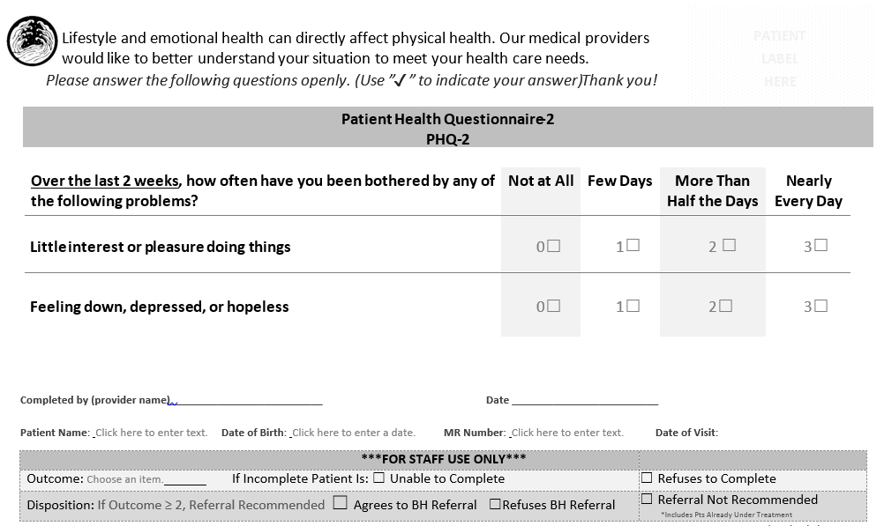
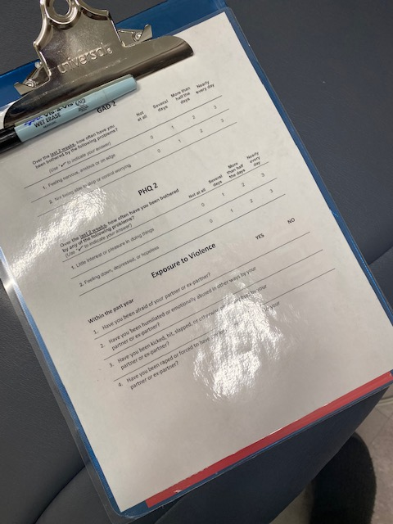
Electronic Workaround Example

Slide 21

4. Clinical Care System
Collaboratively develop process workflows for the implementation of the mental health and oral health integration.
Establish clear policies and procedures that improve the ability and confidence of team members to engage in the work.

Slide 22
Clinical Care Workflow Example 1
Patient presents to dental clinic
Score less than 2
No further assessment
PHQ-2
Registered Dental Assistant or Registered Dental Hygienist administers depression screening
Score greater than or equal to 2
Administer PHQ-9
PHQ-9 score 1-9: No action needed
Document in EHR
Referral for mental health (MH) (i.e., clinical social worker), if patient agrees.
Appointment scheduled and message sent to MH
Dentist reviews score with patient
PHQ-9 score 10+ and 0 on question 9
PHQ-9 score 10+ and 1+ on question 9
Send message via EHR to MH
Arrange for same-day warm handoff

Slide 23
Clinical Care Workflow Example 2
Score: 0
Dental assistant reviews with patient and enters into EHR
Score: 1-13
Explain to patient that they screened positive for some symptoms of depression. Offer to make a referral to someone from our MH team.
Administer PHQ-2
Score: 14+
Explain to patient that they screened positive for some symptoms of depression. Would they like to speak to someone from our MH team today?
Score: 1-2
Administer PHQ-9
Score 14+ and patient is visibly upset/in crisis
Explain to patient that they have screened positive for some symptoms of depression and that they will connect them with a member of our MH team before moving on with their dental treatment.

Slide 24
5. Evaluation System: Minimum Core Set of Measures
UDS measure: Percentage of patients aged 12 years and older screened for depression using an age-appropriate standardized depression screening tool and, if positive, a follow-up plan is documented.
Percentage of patients who were screened for depression
Percentage of patients who were screened for depression with a positive screening result
Percentage of patients with a positive screening result that had a follow-up plan documented
Notes:
In the NNOHA IBOH learning collaboratives we use the UDS measure as the basis for a set of three measures that we ask participating health centers to report on.

Slide 25





Lessons Learned
Executive leadership support
Health IT challenges
Leverage mental health team
Training for dental team members
Evaluation for continual improvement

Slide 26
How Health Centers are Integrating Mental and Oral Health
Panel Discussion
26
Notes:
Panelist questions:
Tell us about how your health center/organization integrates dental and mental health services. (5 min)
What guidance would you offer to a health center considering integrated dental and mental health services? (3 min)
(backup) What has been your biggest challenge in implementing integrated oral/mental health? How have you addressed that challenge?

Slide 27

Panelists
Selynn Edwards, DDS
Marielys Santiago Matos, MSc
Migdala Perez Rivera, PhD
Laury Rios, DDS
Rebecca Cornille, DDS

Slide 28

Q&A

Slide 29

Health Center Satisfaction Assessment
We’d love your feedback on today’s session!
Please take 2 minutes to complete the Health Center TA Satisfaction Assessment.
You must complete the assessment to claim continuing education credit.
Thank you for your time!
https://www.surveymonkey.com/r/OralHealthWebinar

Slide 30




Thank You!
bphc.hrsa.gov
Questions? Reach out via the BPHC Contact Form
Sign up for the Primary Health Care Digest
Notes:
URL for BPHC website:
https://bphc.hrsa.gov/
URL for BPHC Contact From:
https://hrsa.my.site.com/support/s/
URL for Primary Health Care Digest subscription:
https://public.govdelivery.com/accounts/USHHSHRSA/subscriber/new?qsp=HRSA-subscribe

Slide 31





Connect with HRSA
Learn more about our agency at:
www.HRSA.gov
FOLLOW US:

Slide 32
Resources/References
U.S. Department of Health and Human Services Health Resources and Services Administration (HRSA). (2014). Integration of Oral Health and Primary Care Practice. https://www.hrsa.gov/sites/default/files/hrsa/oral-health/integration-oral-health.pdf
HRSA Health Center Program. (n.d.) Uniform Data System 2024 Manual: Health Center Reporting Requirements. https://bphc.hrsa.gov/sites/default/files/bphc/data-reporting/2024-uds-manual.pdf
HRSA. (2024). National Health Center Program Uniform Data System (UDS) Awardee Data. https://data.hrsa.gov/topics/healthcenters/uds/overview/national

